Slide 1

Lab 1 Assignment Submission
By Mithun Tiruvedula
2862112962

Slide 2
Part 1
I did a cursory read of the Virtualbox tutorial as I already have prior experience with Virtualization and linux.
I am a CS undergrad student, and worked as a Software Engineer for 4 years.
Where I had the privilege to learn and deploy virtualizations of all types. (VMs, containers, pods, etc.)
I also did a cursory read of the Virtualbox tutorial as I also have extensive experience working in the Linux ecosystem.

Slide 3
Part 2

Slide 4
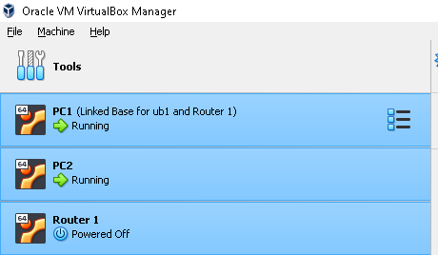


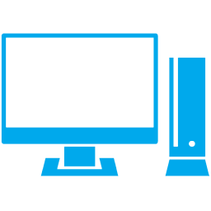
Downloaded Ubuntu desktop image from here.
Faced a permissions problem using sudo. Solved using this solution.
Set up 3 VMs in the following topology
Virtualbox
Router
enp0s8
enp0s8
enp0s9
enp0s8
PC1
enp0s3
PC2
enp0s3
enp0s3
Host

Slide 5
Static IP Allocations
VM | Interface | Type | IP Address | Network
PC1 | Enp0s8 | Static | 192.168.1.1 | Intnet-1
PC2 | Enp0s8 | Static | 192.168.2.1 | Intnet-2
Router | Enp0s8 | Static | 192.168.1.254 | Intnet-1
 | Enp0s9 | Static | 192.168.2.254 | Intnet-2

Slide 6
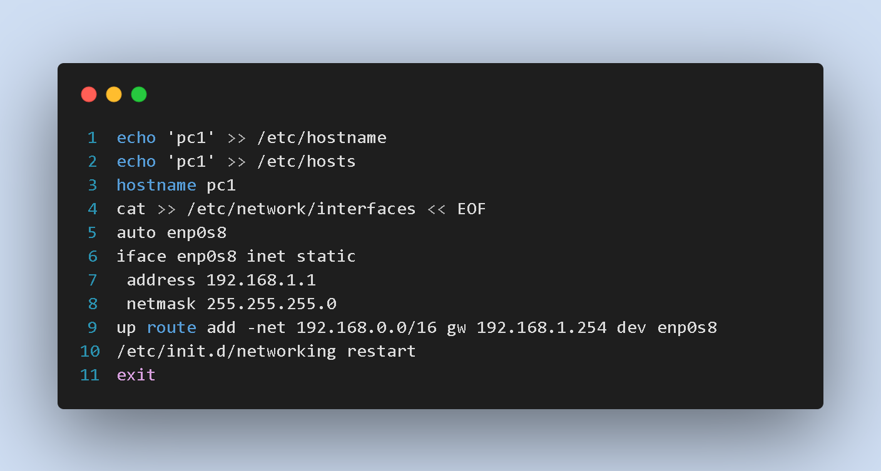
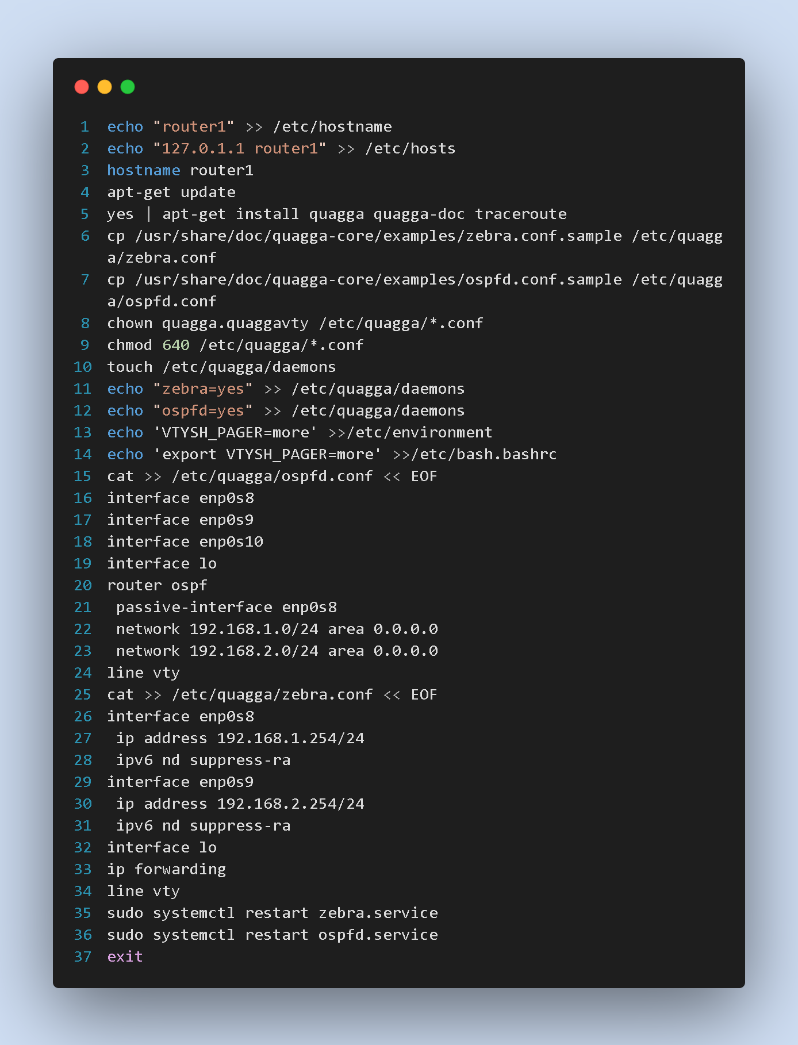

Ran the following commands on PC1 PC2 and Router

Slide 7
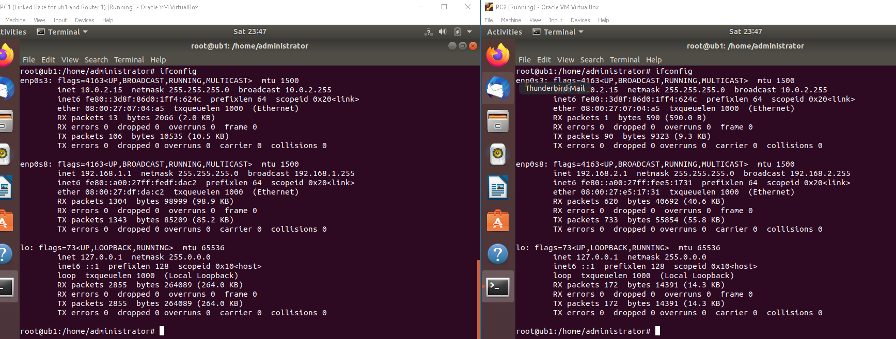
The VMs (PC1 and PC2) are able to communicate through VM Router

Slide 8
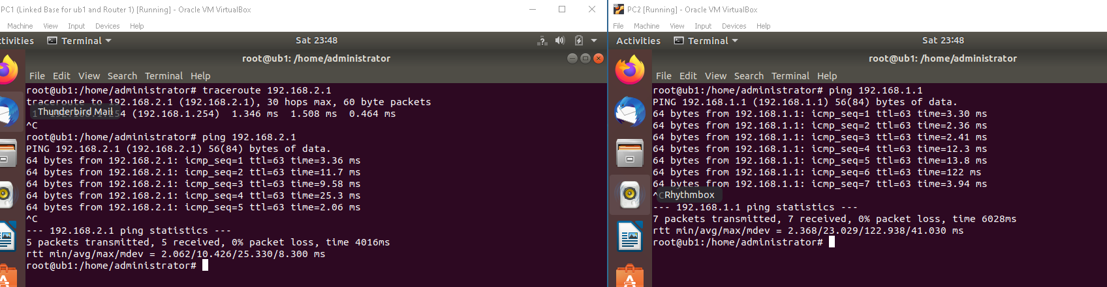
The VMs (PC1 and PC2) are able to communicate through VM Router

Slide 9
Part 3

Slide 10
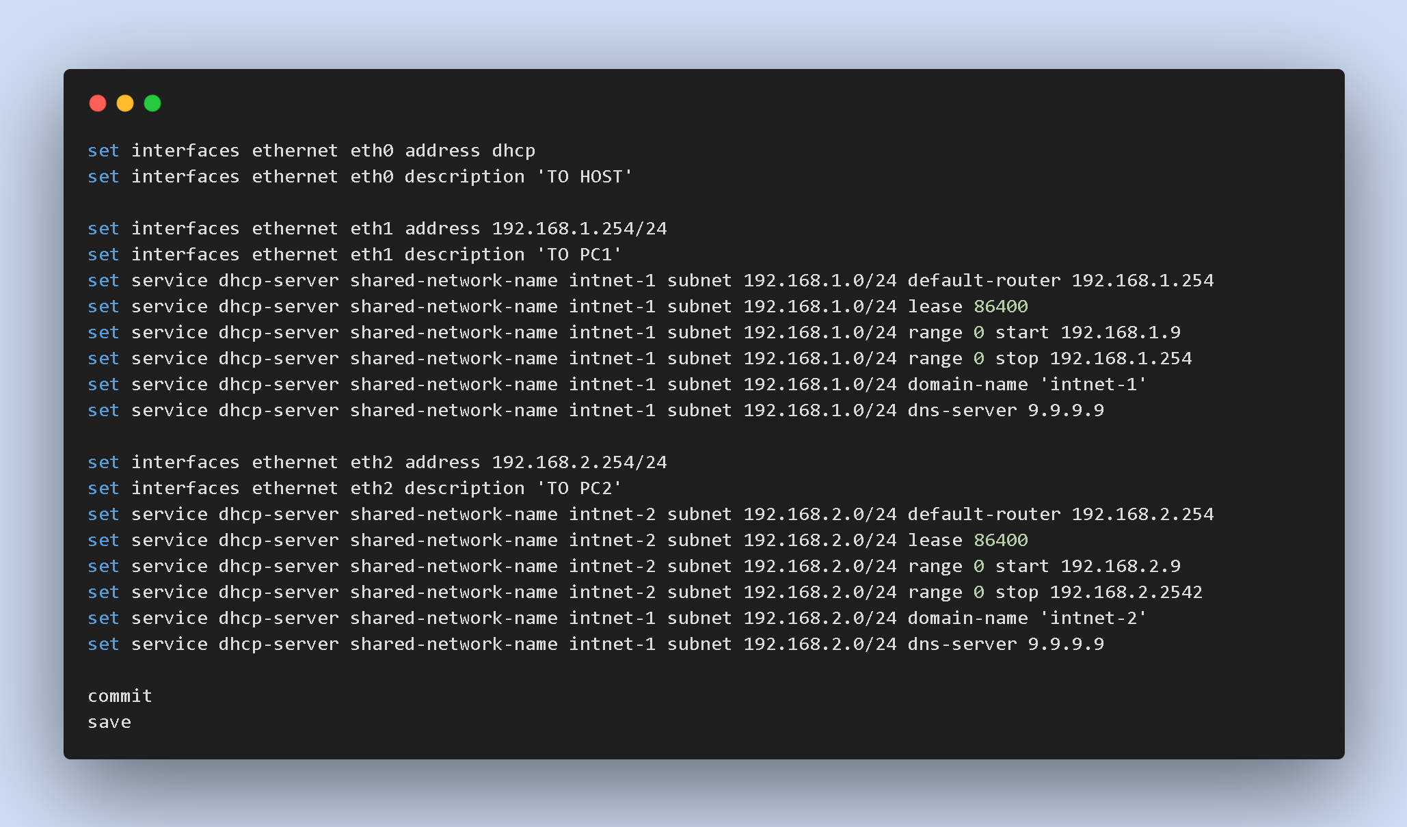
Downloaded VyOS image from here.
Installed on disk to remove OS image ISO
Set up following config on the VyOS server
Shut off the quagga RouterVM and restarted all VMs

Slide 11
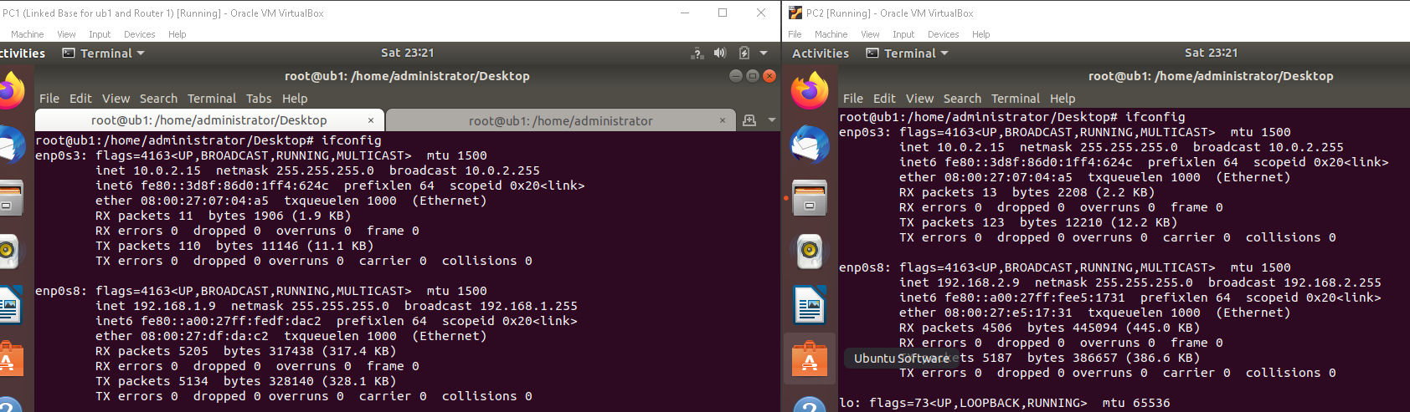
IP Addresses allocated dynamically to VMs PC1 and PC2 by VyOS VM in configured range

Slide 12
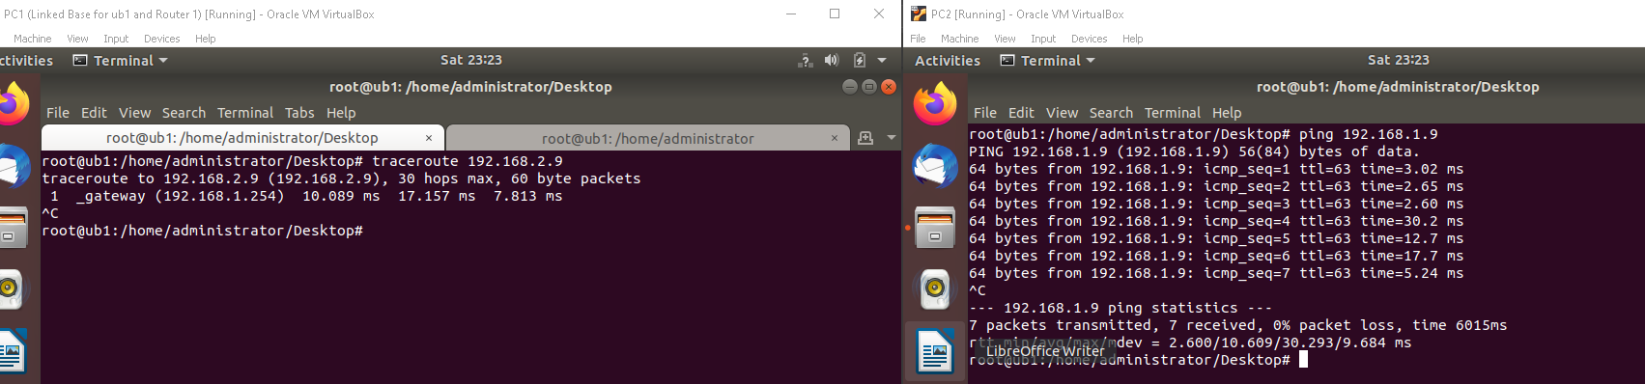
The VMs (PC1 and PC2) are able to communicate through VyOS Router

Slide 13
Part 4

Slide 14
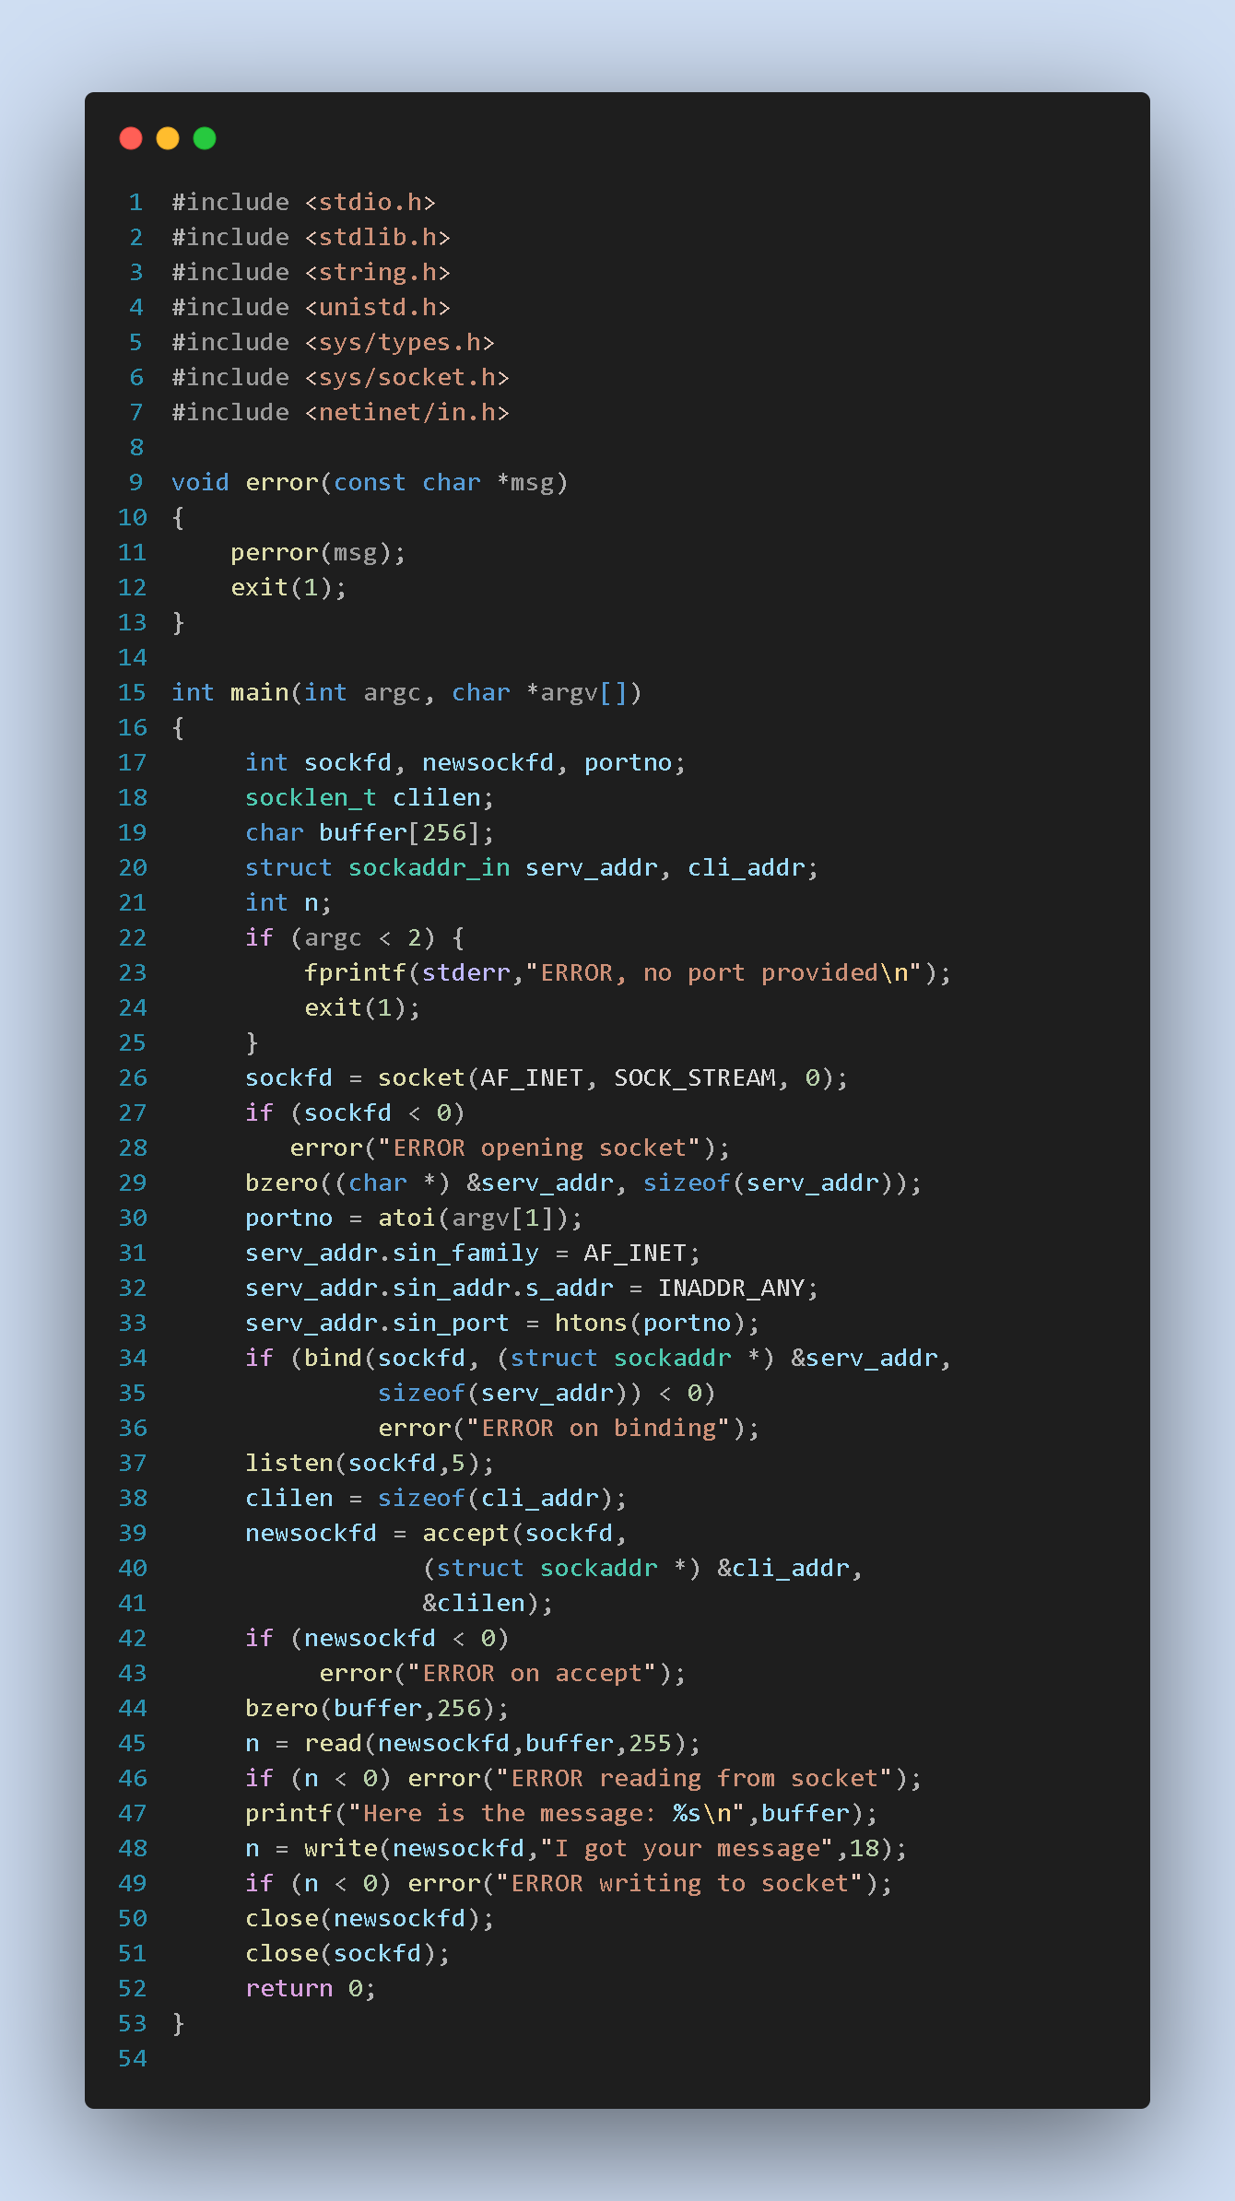
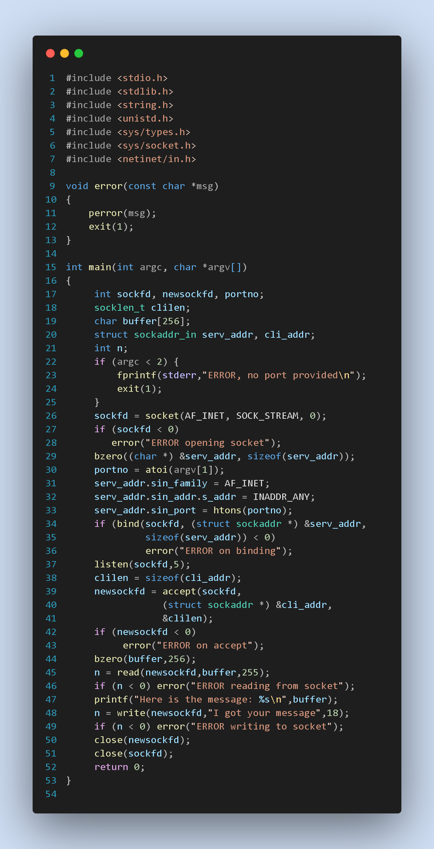
4A
TCP Server
TCP Client

Slide 15
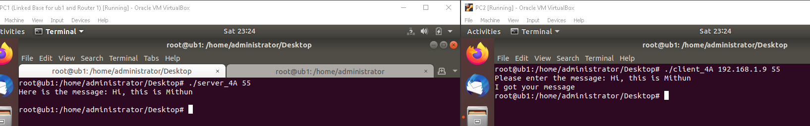
Output

Slide 16
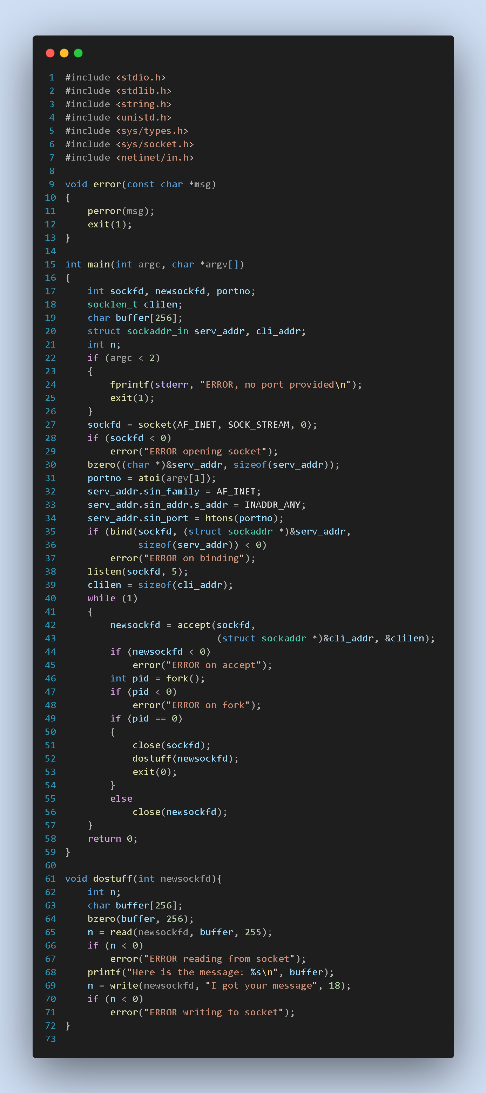
4B
TCP Server Multiclient
TCP Client

Slide 17
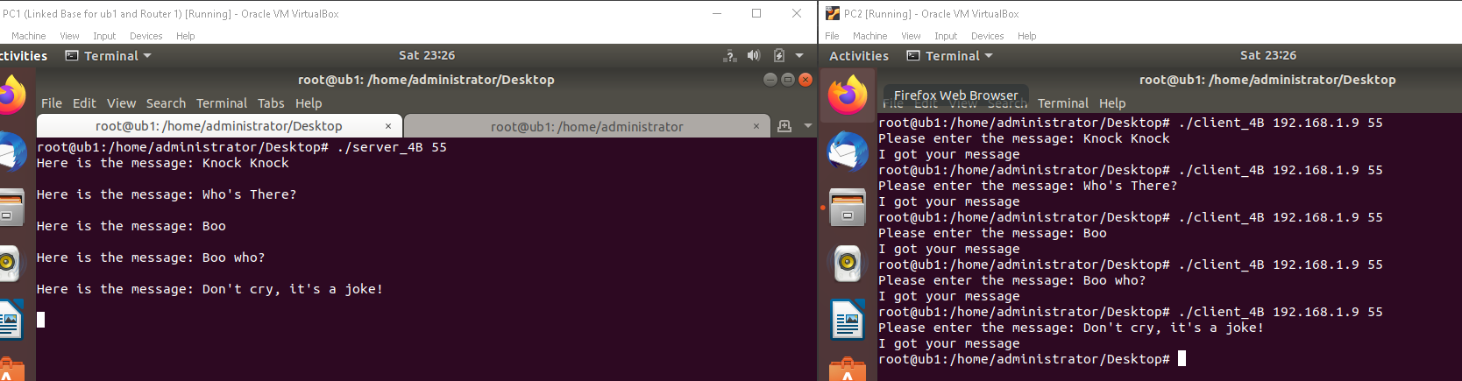
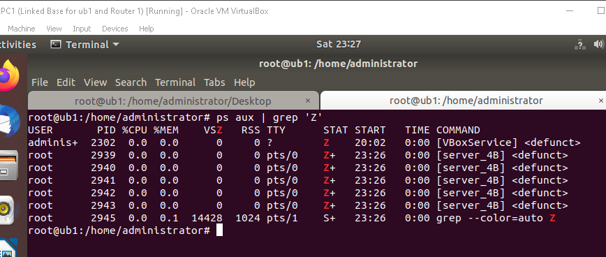
Output

Slide 18
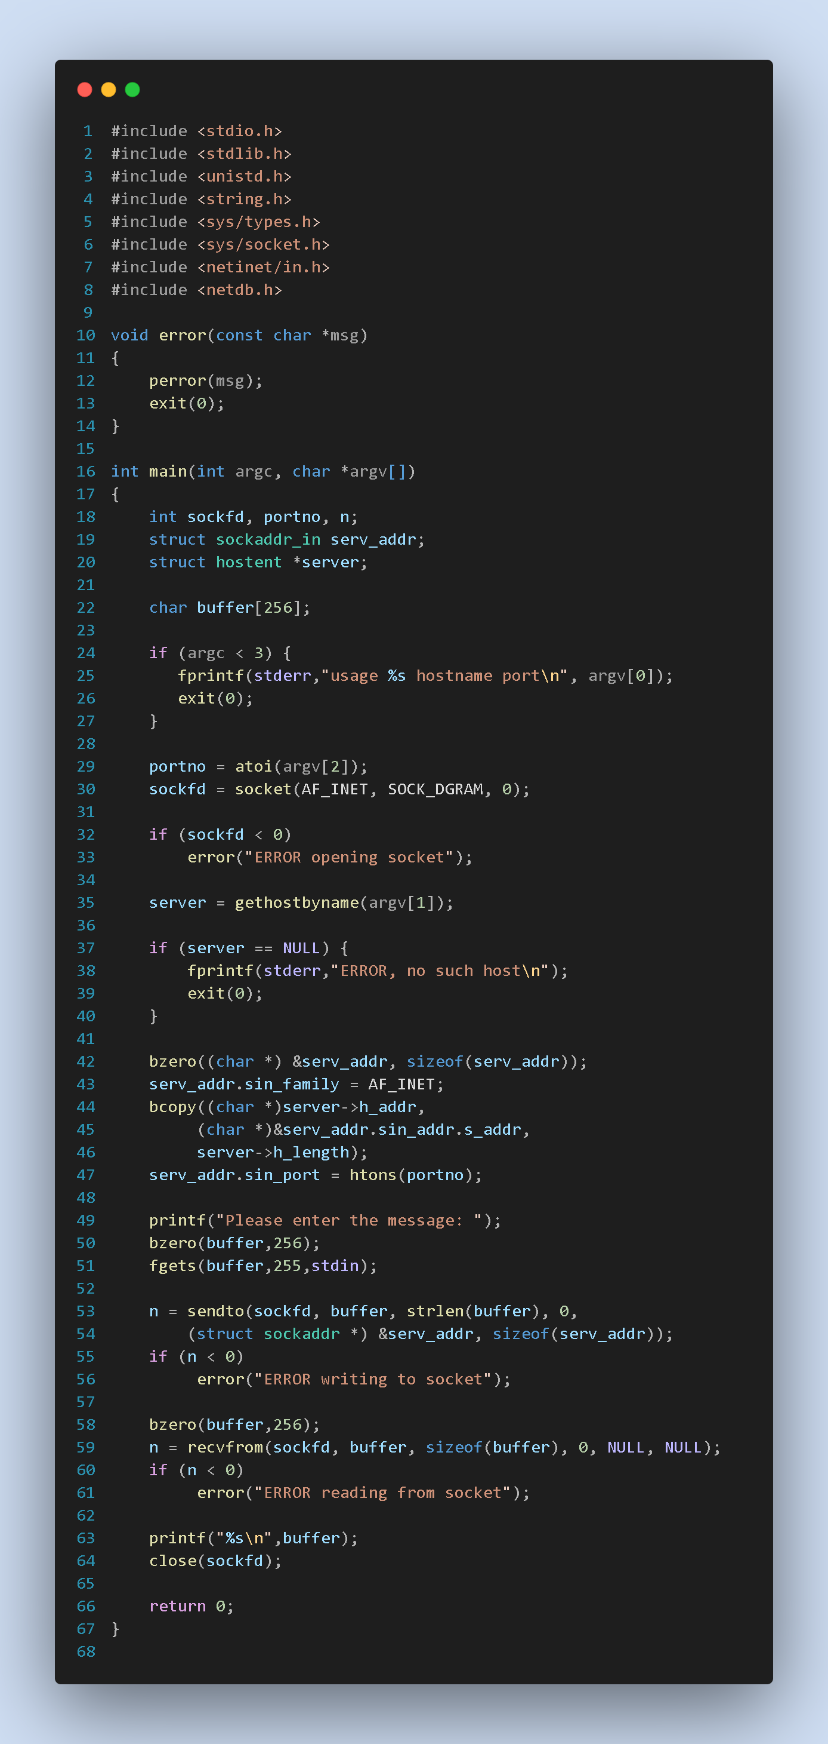
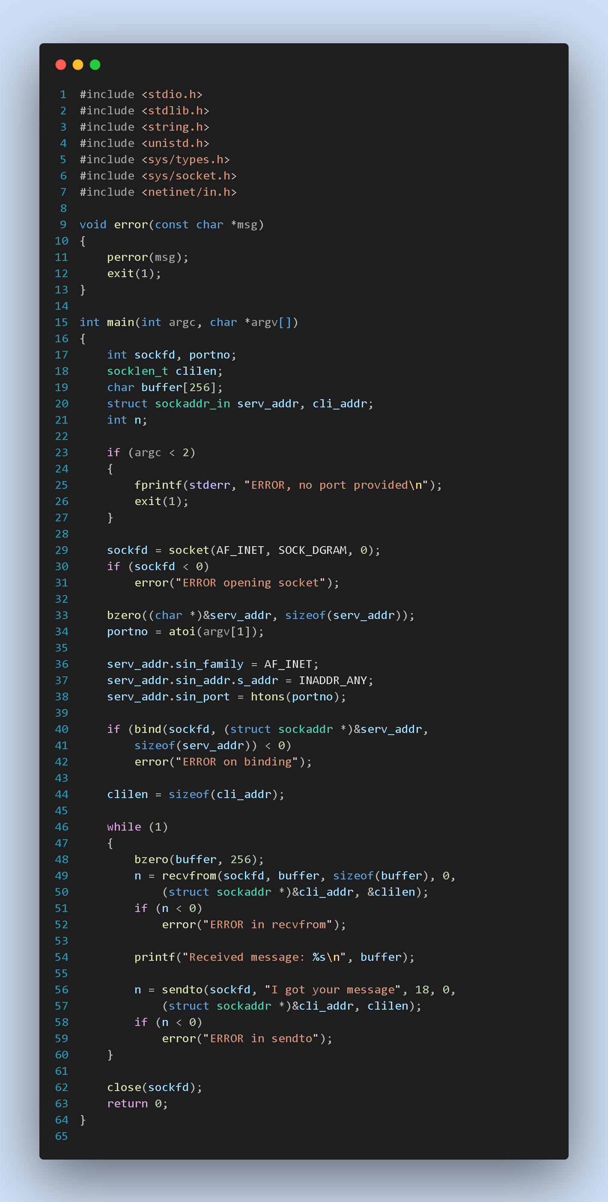
4C
UDP Server Multiclient
UDP Client
Solves Zombie process problem

Slide 19
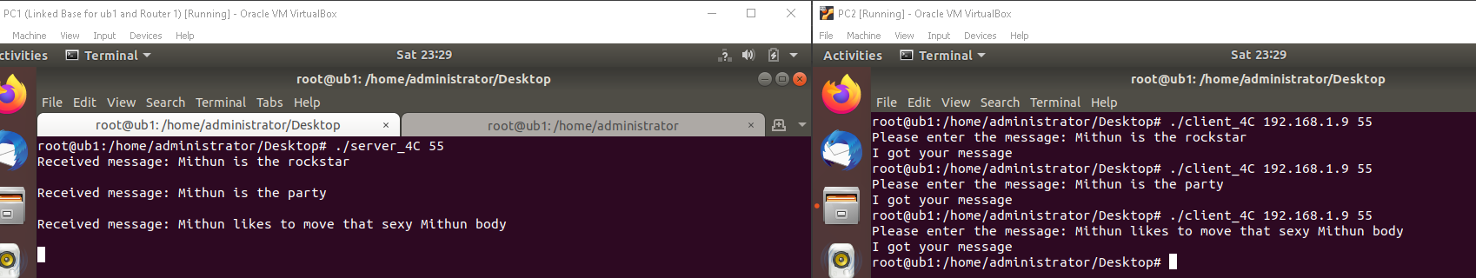
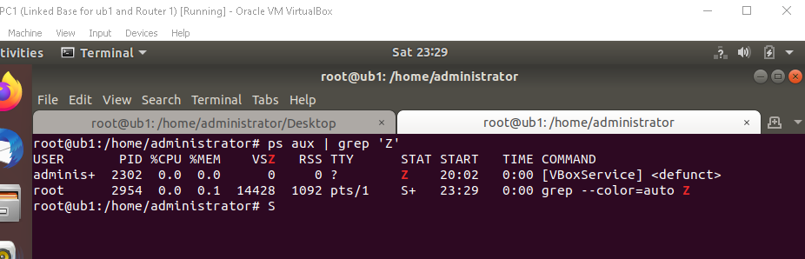
Output

Slide 20
Thank you
By Mithun Tiruvedula
USCID: 2862112962
Mithun.tiruvedula@usc.edu
Source files at: https://github.com/TiruvedulaMithun/EE542_Lab1

